Slide 1
Superstore Sales and Profitability Analysis Dashboard
Analysis of sales performance, profitability, customer segments, product categories, and regional trends
Presented by: Aderogba Oluwapelumi S.

Slide 2
Dataset Overview
The Superstore dataset contains retail transaction records including customer information, product details, sales, discounts, profits, shipping information, and regional data.
Dataset Features
Rows: 9,994
Columns:21
Order Information
Customer Information
Product Information
Geographic Information
Sales and Profit Metrics
Key Variables
Sales
Profit
Discount
Quantity
Region
Segment
Category
Sub-Category

Slide 3
Business Problem
Objective:
The goal of this project was to analyze retail sales performance and identify factors influencing profitability across products, customer segments, regions, and discount levels
Key Questions
Which regions generate the highest sales and profit?
Which products contribute most to revenue?
How do discounts affect profitability?
Which customer segments drive business performance?
What opportunities exist to improve profitability?

Slide 4
Data Preparation & KPIs
Data Preparation
Converted Order Date and Ship Date to datetime format
Created Order Year, Month, and Quarter fields
Calculated Shipping Days
Created Profit Margin %
Classified transactions as Profitable or Loss-Making
Exported a BI-ready dataset for Power BI
KPIs
Total Sales
Total Profit
Total Orders
Total Customers
Total Quantity Sold
Profit Margin %

Slide 5
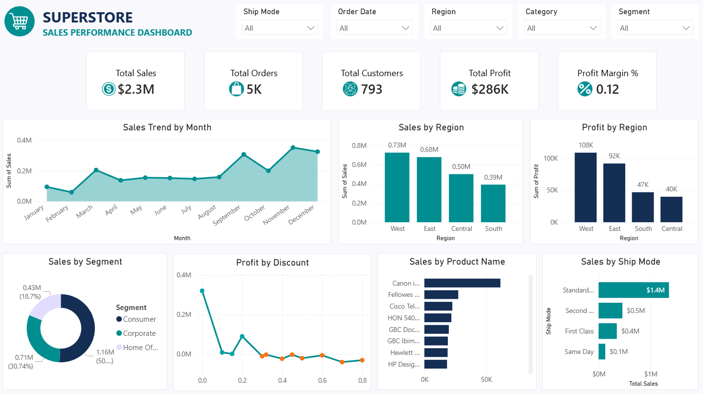
Dashboard Overview

Slide 6
Key Insights
The business generated $2.3M in total sales, $286K in total profit, processed 5K orders, and served 793 customers.
Sales increased significantly toward the end of the year, with November recording the highest monthly sales ($352.2K), followed closely by December ($325.3K).
February recorded the lowest sales performance ($60K), suggesting weaker customer demand during the early part of the year.
Profitability declined as discount levels increased, with discounts above 30% generally resulting in negative average profits.
The West region generated the highest sales ($725.5K), followed by the East region ($678.8K), while the South region generated the lowest sales ($391.7K).
The Canon imageCLASS 2200 Advanced Copier was the top-selling product, generating approximately $61.6K in revenue, while technology and office equipment products dominated the highest-performing product list.
Standard Class shipping generated approximately $1.4M in sales, making it the most utilized shipping method by a significant margin.

Slide 7
Recommendations
Review and optimize discount strategies, particularly for discounts above 30%, as higher discount levels consistently reduced profitability and often resulted in losses. Campaigns should prioritize moderate discount levels that drive sales without significantly eroding profit margins.
Increase investment in high-performing regions, particularly the West and East regions, through targeted marketing campaigns and customer retention initiatives to maximize revenue growth in the strongest markets.
Develop improvement strategies for underperforming regions, especially the South region, by investigating factors such as customer demand, product availability, pricing, and competition that may be limiting sales performance.
Prioritize inventory and promotional efforts for top-performing products such as the Canon imageCLASS 2200 Advanced Copier and other top-selling technology and office equipment items.
Leverage the dominance of Standard Class shipping by continuing to optimize its efficiency and customer experience, while exploring opportunities to increase adoption of other shipping options.

Slide 8
Conclusion
This analysis revealed key drivers of sales and profitability within the Superstore business. While the company generated strong revenue and maintained overall profitability, opportunities exist to improve performance by optimizing discount strategies, strengthening underperforming regions, and focusing on high-value products and customer segments. By leveraging insights from sales trends, regional performance, product profitability, and shipping operations, the business can make more informed decisions that support sustainable growth and improved profitability.

